Slide 1
CUSTOMER ASSISTANCE CHATBOT
Abhilash Saj George(AM.SC.P2CSC19002)
Harikrishnan P S (AM.SC.P2CSC19018)

Slide 2
INTRODUCTION -CHATBOT
Chabot's are self-help tools for improving communications.
Brands can use it to improve their customer's experience, to generate more sales and build a deeper rapport with customers.
They allow your customers to easily interact with your brand through stimulated conversations
Monitoring Consumer Data & Gaining Insights
Cost Savings
According to IBM research, businesses spend $1.3 trillion on 265 billion customer service calls each year.
IBM estimates chatbots can successfully answer up to 80% of routine questions. Costs are far lower as a chatbot can address thousands of queries at once, whereas humans are limited to one query at a time.

Slide 3
Features
In this project we are introducing a customer assistance chat bot with the help of IBM Watson.
Speech Recognition
NLP
Intent, Entity Recognition, Dialog Flow, Basic Interactions
Complaints

Slide 4
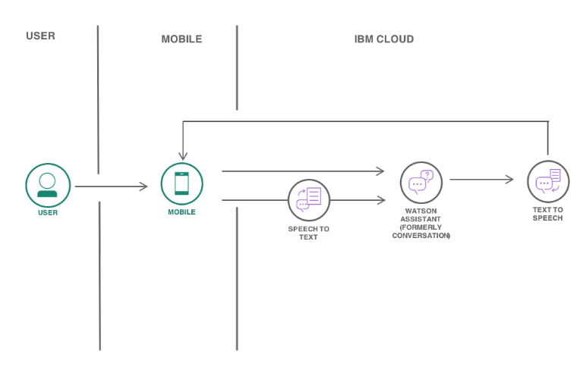

Slide 5
Watson Assistant
It is a question answering computer system capable of answering questions in natural languages, developed by IBM
Intent
Entities
Dialog
Options
Webhooks, Disambiguation, Autocorrection, Irrelevance detection
Analytics
Overview, user conversations
Content Catalog

Slide 6
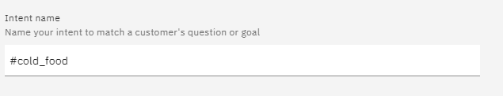
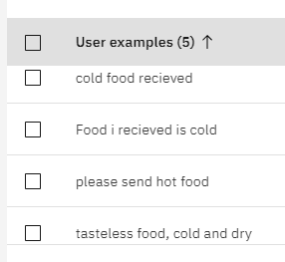
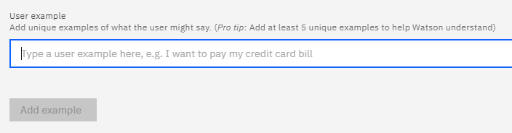
Intent
Intent are purposes or goals that are expressed in a customer's input.
By recognizing the intent expressed in a customer's input, the Watson Assistant service can choose the correct dialog flow for responding to it.

Slide 7
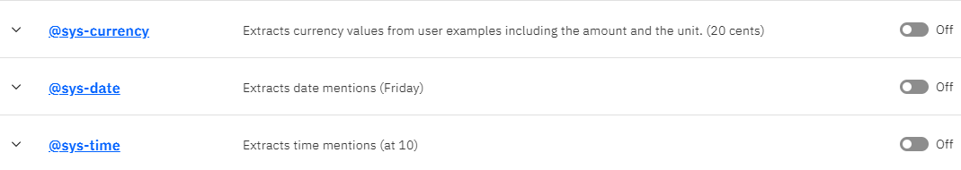
Entities
Entities are like nouns or keywords. By building out your business terms in entities your assistant can provide targeted responses to queries
You can also enable pre-built system entities to capture common phrases such as dates, times and numbers.

Slide 8
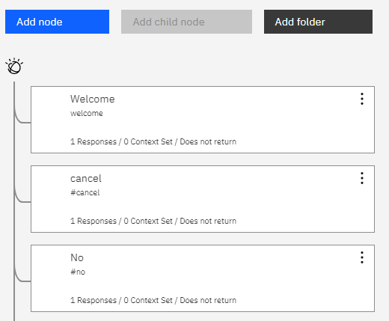
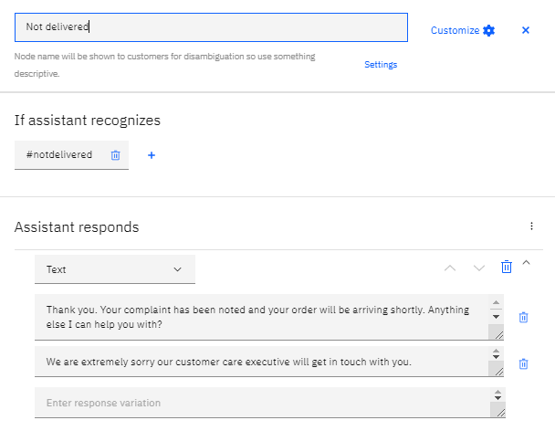
Dialog
Dialog defines what our assistance say in response to the customer.

Slide 9
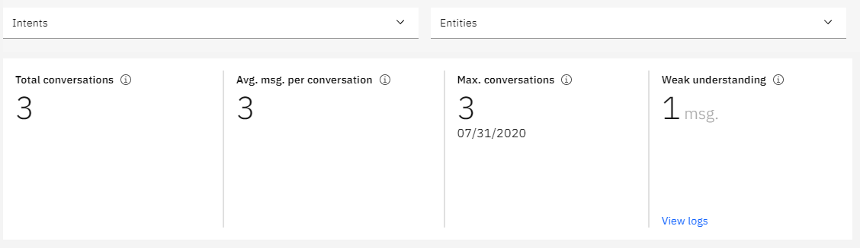
Analytics – Overview and user conversations
Will give full details about the users like what the user mostly talk , How many users chat etc.
Total conversations, Avg msg per customer, Max. conversations, Weak understanding, top intents, etc

Slide 10
Demo

Slide 11
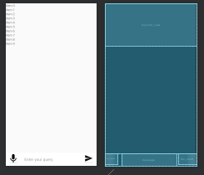
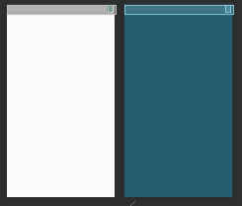
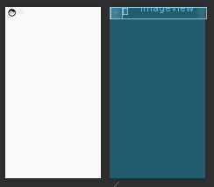
Design

Slide 12
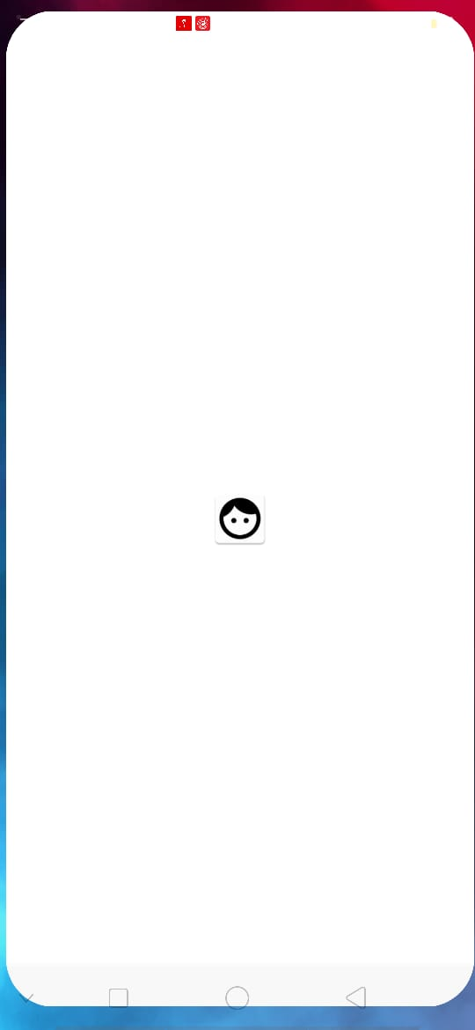
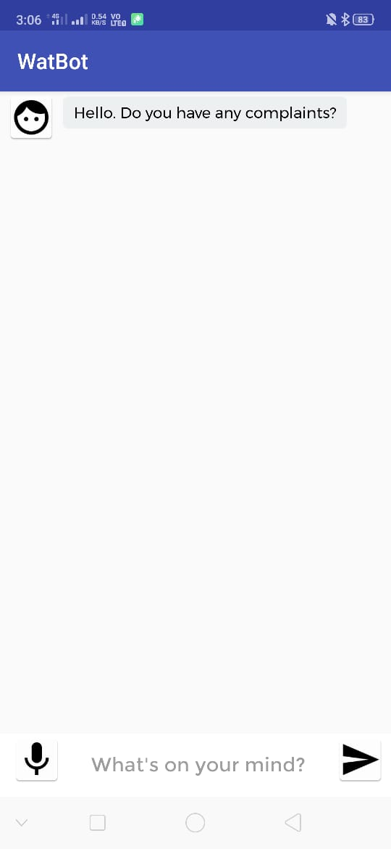
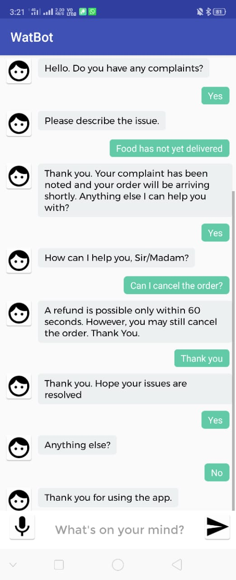
Screenshots

Slide 13
Thank You

